Slide 1
PRESENTATION OF DOMEL
ŽELEZNIKI, 2021
CONFIDENTIAL

Slide 2
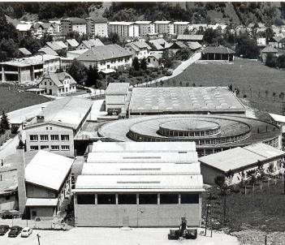
MAIN ADVANTAGES OF DOMEL GROUP
Tradition and loyal employees are the foundations that have made Domel a reliable partner since 1946.
Vertical integration and a broad range of technological knowledge are our competitive advantages. Our operating procedures feature high-tech equipment, automation and robotization, which form the basis for building competitiveness and excellence.
Our sustainable and innovative products are the result of in-house development and technologies. We demonstrate this through being a developmental supplier to the world’s top brands.
CONFIDENTIAL

Slide 3
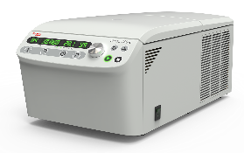
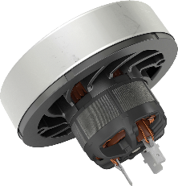
MAIN ADVANTAGES OF DOMEL GROUP
We operate globally. Domel is headquartered in Slovenia, with manufacturing plants in Slovenia, Serbia and China.
Our motors power over 300 million appliances all over the world.
The quality of our final products is reflected in their exceptionally long lifetimes, low noise and ultra-high efficiency, which reduces power consumption.
CONFIDENTIAL

Slide 4
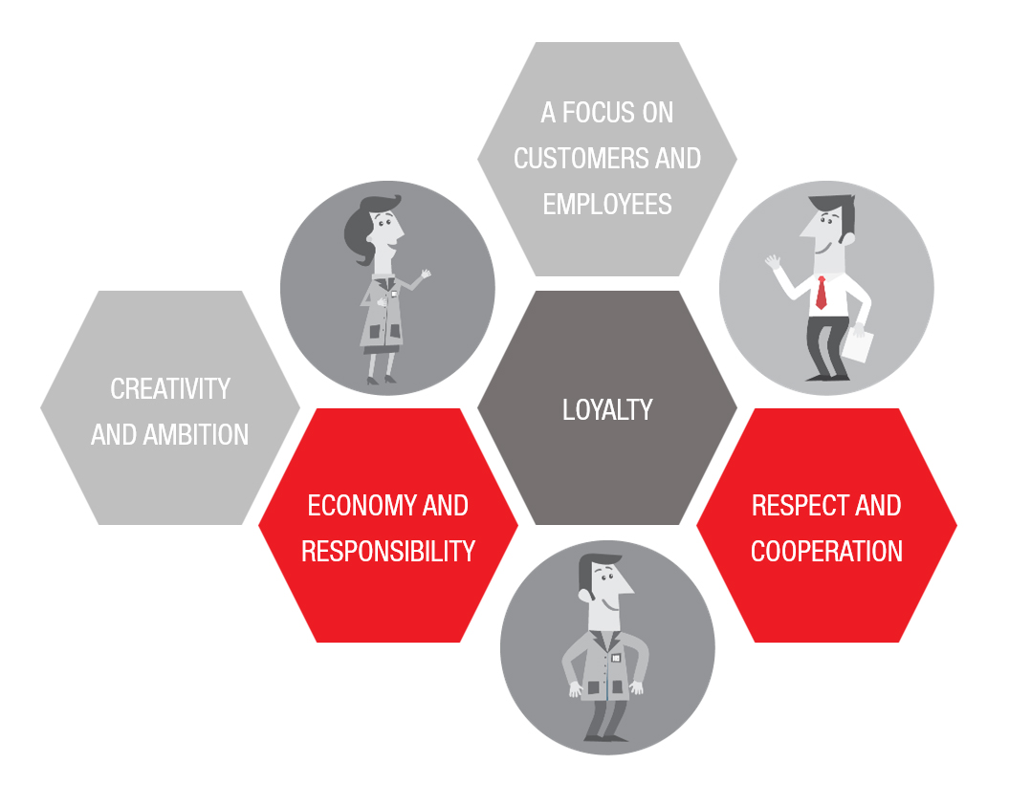
VALUES
CONFIDENTIAL

Slide 5
DOMEL GROUP TODAY
6
1394
150
LOCATIONS
EMPLOYEES
MIO EUR
LOKACIJ
ZAPOSLENIH
MIO EUR
CONFIDENTIAL

Slide 6
LOCATIONS
HEADQUARTERS
ŽELEZNIKI / SLO
ŽELEZNIKI/SLO
TRATA / SLO
RETEČE / SLO
ODŽACI / SRB
SUZHOU /CHINA
30.927 m2
4.620 m2
25.000 m2
13.725 m2
1.600 m2
3.200 m2
CONFIDENTIAL

Slide 7
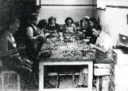
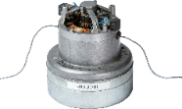
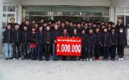
MILESTONES
1946
1992
2009
Company founded
EC blowers
Serial production of EC motors
1974
2006
Development of the first vacuum cleaner motor
Domel China Suzhou
CONFIDENTIAL

Slide 8
ORGANISATION
DOMEL HOLDING, d.d.
Sales
Purchasing
General Affairs
Finance and Accounting
Domel IP, d.o.o.
DOMEL, d.o.o.
Domel Energija, d.o.o.
Logistics
Development
Quality
Domel Inc.
Bussines unit Commutator Motors
Domel Electric Motors Suzhou Co. Ltd
Bussines unit Components & Tools
Domel motors doo Odžaci
Bussines unit EC Systems
Bussines unit Automotive Program
Bussines unit Laboratory Systems
Bussines unit EC Drives
Bussines unit EC Motors
CONFIDENTIAL

Slide 9
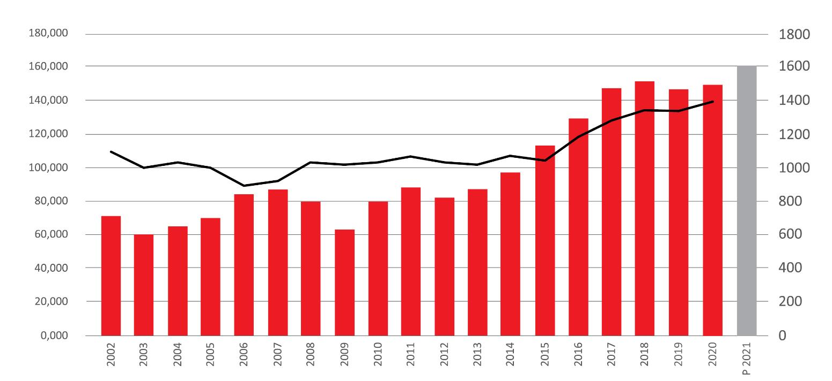
DOMEL GROUP EMPLOYEES AND REVENUE
(MIO EUR)
CONFIDENTIAL

Slide 10
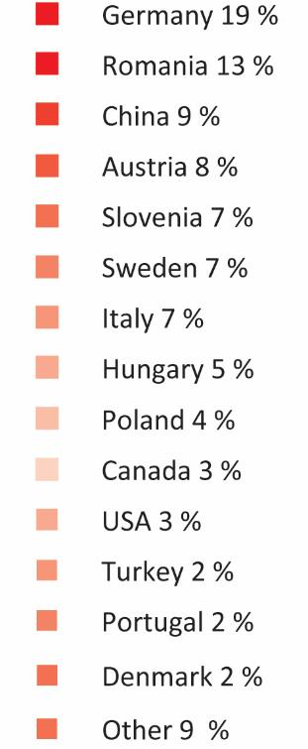
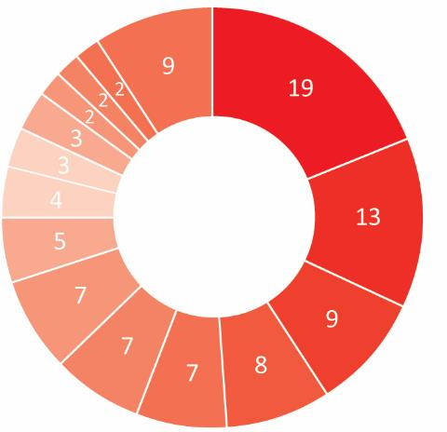
MARKET / SALES 2020 ( % )
CONFIDENTIAL

Slide 11
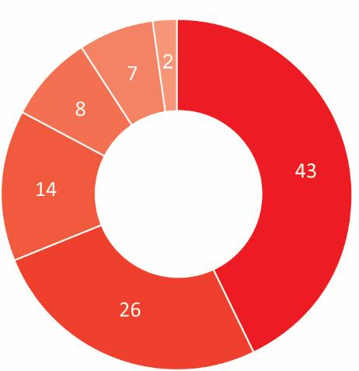
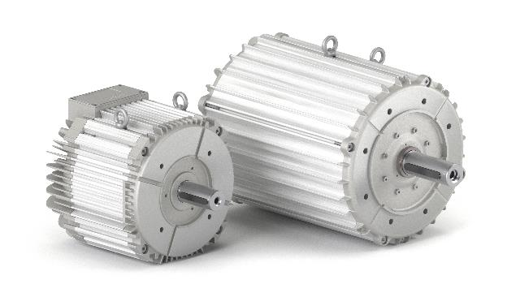
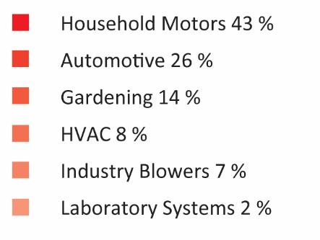
SALES / BY MARKET SEGMENTS
CONFIDENTIAL

Slide 12
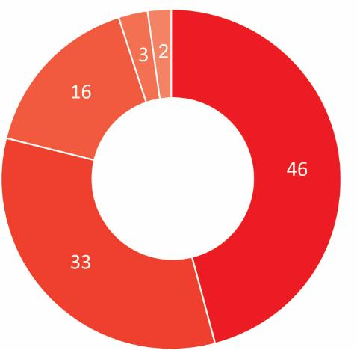
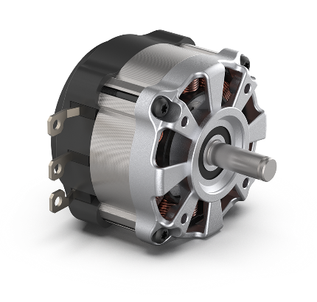
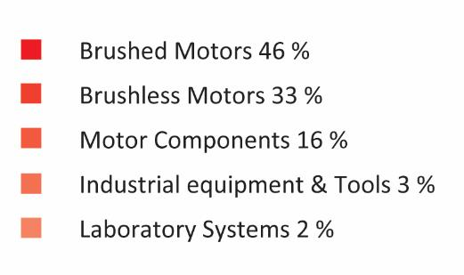
SALES / BY PRODUCTS
CONFIDENTIAL

Slide 13
CUSTOMERS
CONFIDENTIAL

Slide 14
VERTICAL INTEGRATION
Professional & Home Appliances
Industrial
Medical & Healthcare & Laboratory
E-mobility
Stamping of electrical steels
Overmoulding stator insulation
Injection moulding of BMC thermosets
Tool development, design and production
Automation and Robotics
Sales Distribution of robots, linear motion technology, electric drives and controls
Ventilation and Fume extraction
Printing and packing
Compresors and pumps
Centrifuges
Homogenizers
Stirrers
Shakers
Incubators
Watter baths
Automotive
E-bike
E-scooter
Fuel cells
Components
Brushless motors
Permanent Magnet DC motors
Universal Commutator motors
Thermoset components, Electrical steel components, Encapsulated / overmoulded components
Components & Tools, Equipment

Slide 15
LONG – TERM COOPERATION WITH OUR PARTNERS
CUSTOMERS ORIENTED COMPANY, INNOVATIVE SOLUTIONS, LONG TERM COOPERATION
CUSTOMER
ELECTROLUX, Sweden
STIHL, Germany
NILFISK ALTO, Denmark
STEIN & CO, Germany
PHILIPS, Austria
ROBERT THOMAS, Germany
HYLA, Slovenia
WESSEL-WERK, Germany
ROWENTA, France
FAKIR, Germany
GLEN DIMPLEX, Germany
SINGER SEWING MACHINE, China
FESTOOL, Germany
PHILIPS, Netherlands
YEARS OF COOPERATION
47
39
37
37
33
28
28
28
27
27
26
26
24
17
CONFIDENTIAL

Slide 16
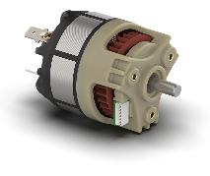
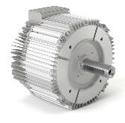
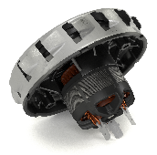
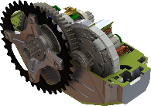
INVESTMENT AND DEVELOPMENT
40 % OF THE PRODUCT ARE
YOUNGER THAN THREE YEARS
OUR INNOVATIVE TECHNOLOGY
INVESTMENT 11 %
DEVELOPMENT 5 %
CONFIDENTIAL

Slide 17
ENVIRONMENT CARE
LESS MATERIAL
HIGHER EFFICIENCY
180GWh
LOWER NOISE
CONFIDENTIAL

Slide 18
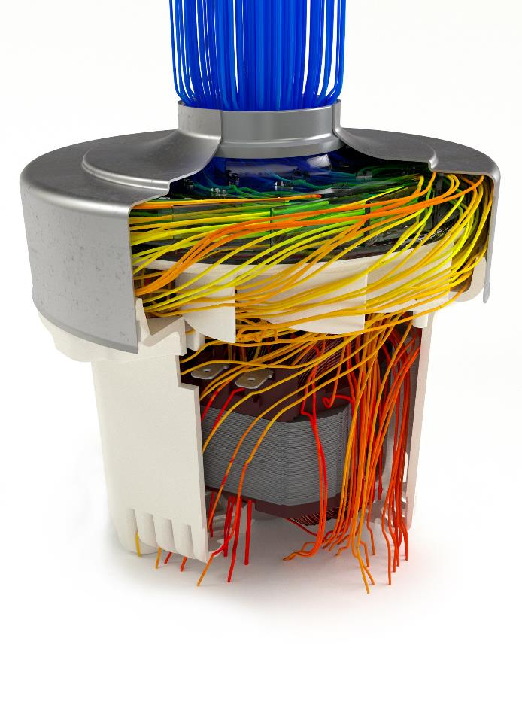
R&D COMPETENCES
MOTOR DESIGN AND CONSTRUCTION
fast response and usage of advanced CAD/CAM tools and rapid prototyping
ROTODYNAMIC
robust, low level the vibration, stable life time, … (Ansys)
ELECTROMAGNETIC
lamination design, low looses (Ansys-Magneto)
AERODYNAMIC
optimal design of blowers, fans, … (Ansys-Fluent)
ACOUSTIC
low noise levels, identification of avoid the critical noise frequences (Bruel & Kjaer)
ELECTRONIC
controller design for BLDC and BLAC motors (Altium design)
MATERIALS
analysis and verification of materials
TESTING
performing testing, structure testing, clima testing
CONFIDENTIAL

Slide 19
KEY TECHNOLOGIES
DESIGN AND PRODUCTION OF TOOLS
Stamping, moulding, overmoulding, die casting tools,…
STAMPING AND STACKING
Rotor and stator stacks with or without interlocking, straight or slanted slots, indexing …
OVERMOULDING OF LAMINATED STACKS, MAGNETS AND INSERTS
Insulation and protection, increased thermal conductivity and structural functionality,…
INJECTION MOULDING OF TERMOSETS (BMC)
Optional moulding of inserts, automated visual geometry inspection,…
BONDING TECHNOLOGIES
Laser, ultrasound and heat wealding, glueing,…
ASSEMBLY AUTOMATIZATION AND DIGITALIZATION
Proces design and industrialisation, 100%-multy-parameter contol,…
MOTOR ASSEMBLY TECHNOLOGY
Winding, magnetising, balancing,…
REVERSE ENGINEERING AND RAPID PROTOTYPING
3D optical scaning, 3D laser printing, …
CONFIDENTIAL

Slide 20
STANDARDS AND TOOL FOR EXCELLENCE
ISO 14001
ISO 9001
IATF 16949
ISO 13485
Project management
SixSigma DMAIC, DFSS
Lean Production
CONFIDENTIAL

Slide 21
MISSION & VISION
MISSION
Domel is a socially responsible company. As a GLOBAL DEVELOPER and SUPPLIER of advanced solutions in the field of electric motors and components based on our own innovative technologies, we enable the growth and sustainable development of the Domel group, in this way providing quality jobs in the broader environment.
VISION
We are a global development supplier of EC systems and components and maintain a leading position as a developer in the vacuum units market.
CONFIDENTIAL

